Slide 1
Meeting Four
DPM Final Project
Fall 2017
Team 6
GANTT and budget review, mechanical changes summary, software progress update, and testing plans up to the beta demo

Slide 2
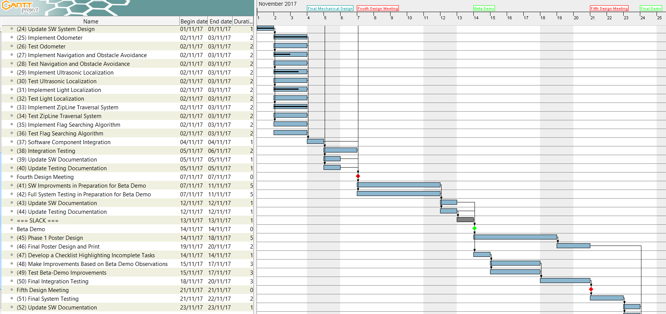
GANTT Chart Update

Slide 3
Budget Update

Slide 4
Mechanical Design Changes
Framework has been simplified, strengthened, and lightened
Wheelbase has expanded to 15.23 cm
Downward-facing colour sensors have been centralized
Heights of front-facing, pivoting sensors have been increased
Centre of gravity of the robot on the zip line has been moved forward
Accessibility to the battery has been improved
Structure of the zip line arm has been simplified

Slide 5
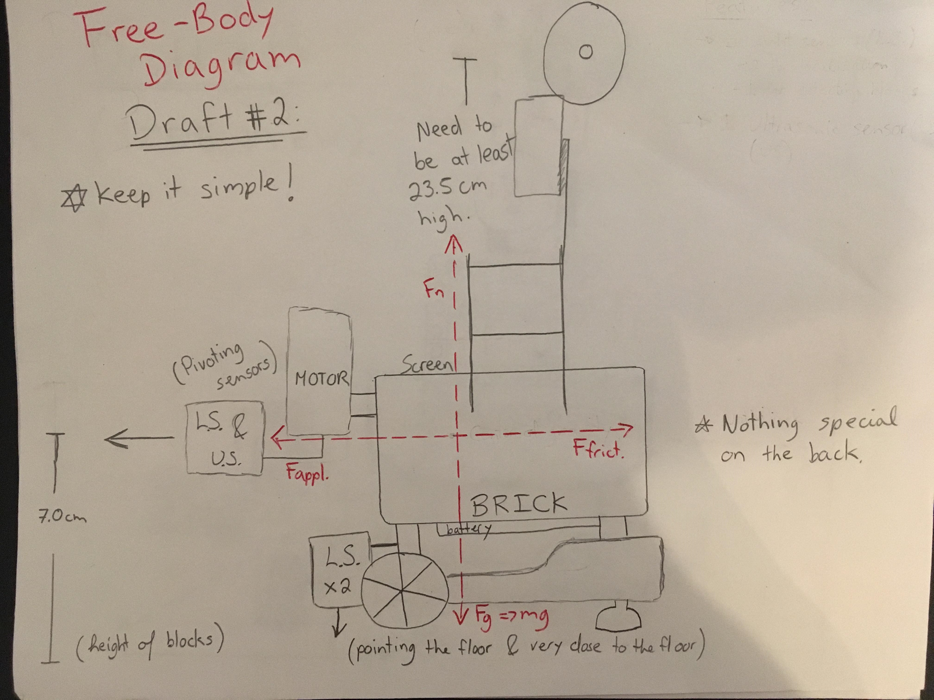
Robot Draft #2 – Free-Body Diagram

Slide 6
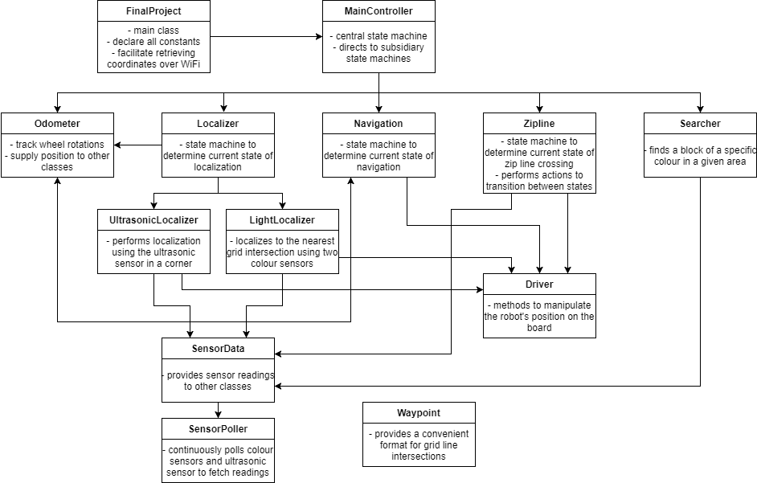
Software Architecture – Brief Update

Slide 7
Testing Plan – Lead-up to Beta Demo
Weaknesses from Laboratory 5 must be thoroughly tested
Localization at the zip line start point will be a focus
Elements that were not part of any lab demo must be tested
Localization after zip line dismount
Navigation to the flag area
Finding and capturing a flag
Localization after capturing a flag
Navigation back to the start point
Elements related to the longer length of the beta demonstration must be tested
Accuracy of navigation over longer distances
Battery depletion during continuous operation
Preliminary testing related to the integration of separate pieces of software must be conducted

Slide 8
Week 4 Plan
Prepare for beta demonstration
Complete the entirety of the code base
Conduct individual tests on each piece of the software architecture
Conduct preliminary integration testing – this will not be finalized before the beta demonstration, but some level of integration is necessary for a successful demo
Update GANTT chart and budget
Verify that enough budget remains for the final weeks of the project, which could present more unexpected hurdles than the initial weeks
Update documentation with the latest details for Monday’s submission
Documentation will be submitted online, despite the lack of a meeting next Tuesday

